Slide 1
Data analytics
[ EXCEL , SQL , PYTHON , POWER BI ]

Slide 2
Student performance ANALYSIS
TEAM
K.GUNDURAO
AKSHAY JOSHI
DODDA BASAPPA

Slide 3
abstract
This project focuses on developing a comprehensive student performance analysis dashboard using Power BI and Python visualizations. The system leverages cleaned student data, including academic indicators like CGPA, department, attendance percentage, and placement status, along with extracurricular parameters such as sports participation, internship experience, and mentor meeting attendance. By integrating these variables, the project aims to uncover patterns and correlations that influence student success.

Slide 4
introduction
In the modern educational landscape, data plays a crucial role in monitoring and enhancing student performance. With the growing need to track not only academic outcomes but also extracurricular involvement and placement readiness, institutions require efficient tools for data analysis and visualization. This project introduces a student performance analysis system that utilizes Power BI and Python to transform raw student data into meaningful insights. The dataset comprises various fields such as CGPA, department, attendance percentage, placement status, sports participation, internship experience, and mentor meeting attendance.

Slide 5
PROBLEM STATMENT
“The objective is to create a student performance dataset using SQL and Excel, retrieve and clean the data using Python, and analyze it to uncover patterns in academic performance through visualizations in Power BI.”

Slide 6
objectives
•Analyze the relationship between attendance and academic performance.
Identify the top-performing student based on CGPA.
•Compare average CGPA across different departments.
Evaluate the impact of sports participation, internships, and mentor meetings on student success.
Display placement status statistics to assess student readiness for the job market.
Present all insights in an interactive and user-friendly format using Power BI and Python visualizations.

Slide 7
Tools used
EXCEL AND SQL
PYTHON
POWER BI
Efficient Data Handling
Advanced Analytical
Functions
Data Cleaning and
Transformation
Integration with Other
Platforms
User-Friendly Interface
Easy to Learn and Use
Extensive Libraries
and Frameworks
Cross-Platform
Compatibility
Strong Community
Support
Interactive Data Visualization
Seamless Integration
with Microsoft Tools
Real-Time Data Analysis
AI-Powered Insights

Slide 8
excel
VLOOKUP / XLOOKUP – Used for searching and retrieving specific values from a dataset.
TRIM – Removes extra spaces from text data.
CLEAN – Eliminates non-printable characters from cells.
TEXT functions (LEFT, RIGHT, MID) – Extract specific portions of text data.
SUBSTITUTE & REPLACE – Modifies text values within cells.
COUNTIF / SUMIF – Aggregates data based on specific conditions.

Slide 9
Sql(sequential query language)
SELECT – Retrieves specific data from tables.
WHERE – Filters data based on conditions.
JOIN (INNER, LEFT, RIGHT, FULL) – Combines data from multiple tables.
GROUP BY – Organizes data into categories for aggregation.
HAVING – Filters grouped data based on conditions.
ORDER BY – Sorts data in ascending or descending order.

Slide 10
python
pandas.read_csv() – Loads CSV data into a DataFrame.
pandas.DataFrame.dropna() – Removes missing values.
pandas.DataFrame.fillna() – Replaces missing values with specified values.
pandas.DataFrame.duplicated() & drop_duplicates() – Identifies and removes duplicate rows.
pandas.DataFrame.rename() – Renames columns for better readability.
matplotlib.pyplot.plot() – Creates basic line plots for trends.
matplotlib.pyplot.bar() – Generates bar charts for categorical data.

Slide 11
POWER BI
Bar & Column Charts – Represents categorical data.
Line Charts – Displays trends over time.
Scatter Charts – Helps visualize correlations between variables.
Pie & Donut Charts – Summarizes proportions.
Map Visuals – Geographic data visualization.

Slide 12
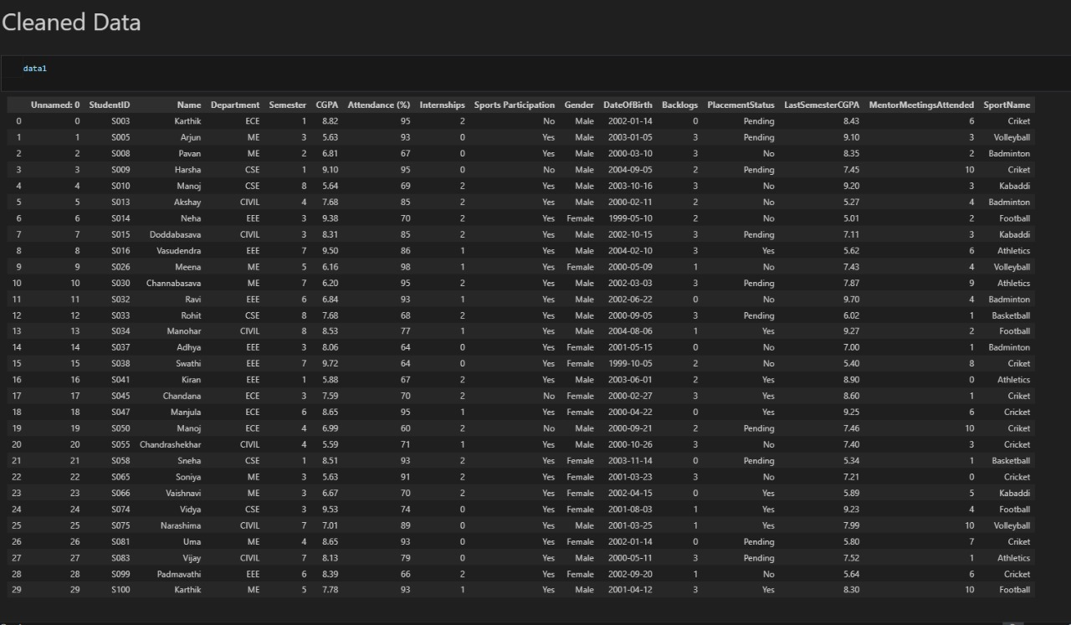
screenshot

Slide 13
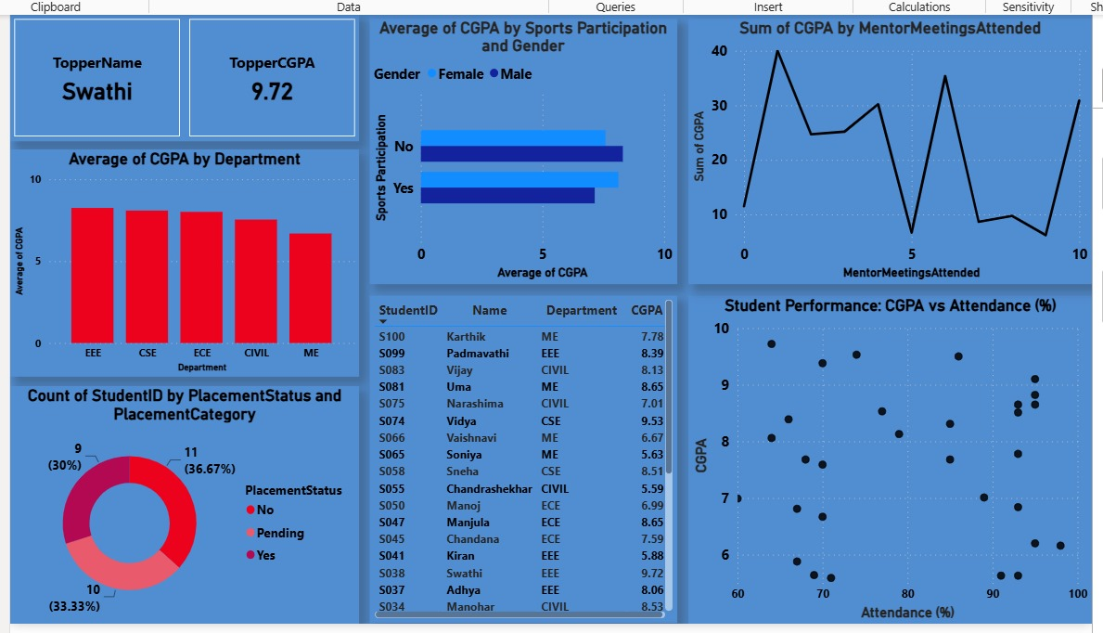
Screen shot 2

Slide 14
CONCLUSION
The Student Performance Analysis Dashboard project successfully demonstrates how data visualization and analysis tools like Power BI and Python can be leveraged to gain meaningful insights into student academic and extracurricular performance. By integrating key parameters such as CGPA, attendance, placement status, sports participation, internships, and mentorship activities, the system provides a holistic view of each student’s development.

